Slide 1
R.S.V.P.
Refund Support Vocations Program

Slide 2
RSVP
Purpose:
This program plants the seeds of greater cooperation between the Knights and those men who will be our future priests in the parishes that we deal with on an ongoing basis.
These men will remember that we helped them when they needed our assistance badly during their formation years.

Slide 3
RSVP
Qualifications:
Councils or assemblies can make an annual contribution of $500 or more to an individual seminarian to help with his daily living expenses.
Minimum annual contribution to qualify for reimbursement is $500 per seminarian.
For every $500 donated, the council or assembly is eligible for a refund of $100 from the Supreme Council.
The maximum refund a council or assembly can receive is $400 per individual supported.

Slide 4
Cont. Qualifications:
For Columbian Squires circles, the annual contribution per seminarian is a minimum of $100 to qualify for reimbursement.
Each circle eligible to receive from the Supreme a refund of $20 for each $100 contributed.

Slide 5
RSVP
Who are eligible to receive RSVP funds:
Seminarians who have been accepted by a diocese and are currently in their “spirituality” year.
Seminarians attending major seminaries (usually, four years) in preparation for priestly ordination.
Seminarians in their “pastoral” year (most often, when they are deacons).
Seminarians attending college seminaries (sometimes called minor seminaries).
Seminarians who belong to a religious institute and are currently in formation for the priesthood (religious seminarians often are called “Brother” even though they will eventually be ordained as priests); and
Men and women who are novices or postulants in religious orders or religious communities

Slide 6
RSVP
Who are not eligible for RSVP funds are the following:
Priests or religious seeking assistance for continuing education.
Religious brothers not currently studying for the priesthood; and
Candidates for the permanent diaconate.

Slide 7
RSVP
DIRECTIVES FOR SECTION I: (RSVP) REFUND INFORMATION
To qualify for the refund, the following conditions must be met:
Money given to each individual must be vocation-related, donated between July 1 and June 30 within the fraternal year applied for and must amount to at least $500 per individual.
b) The money must have been given to an individual and NOT to an institution or fund.
c) Money must be given to a seminarian, postulant or novice only.
d) The money must be paid with a check drawn on the council account.
e) Copies of any canceled cheque(s) (both front and back sides) or other documentation must be attached to this application.

Slide 8
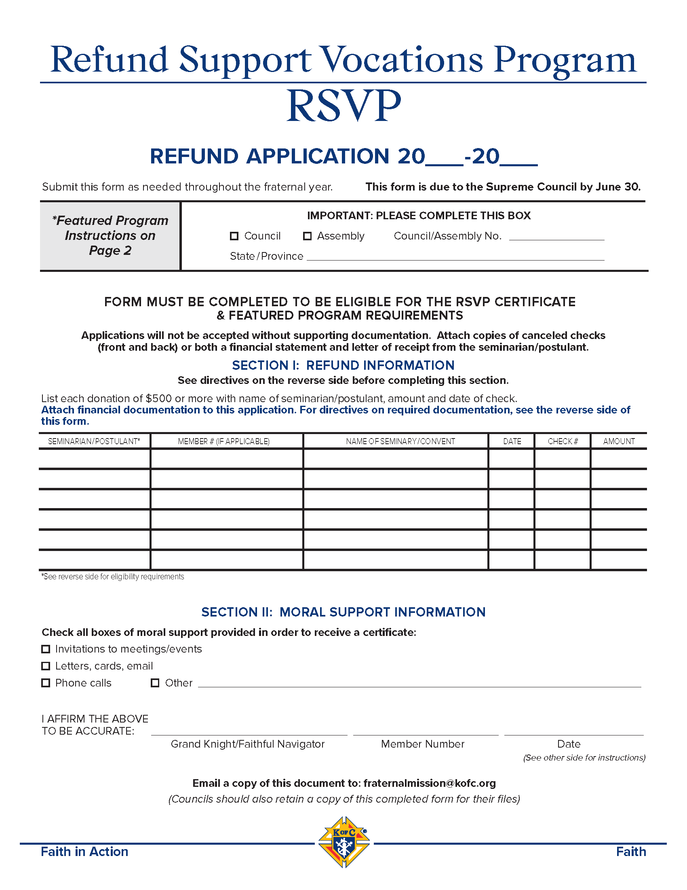
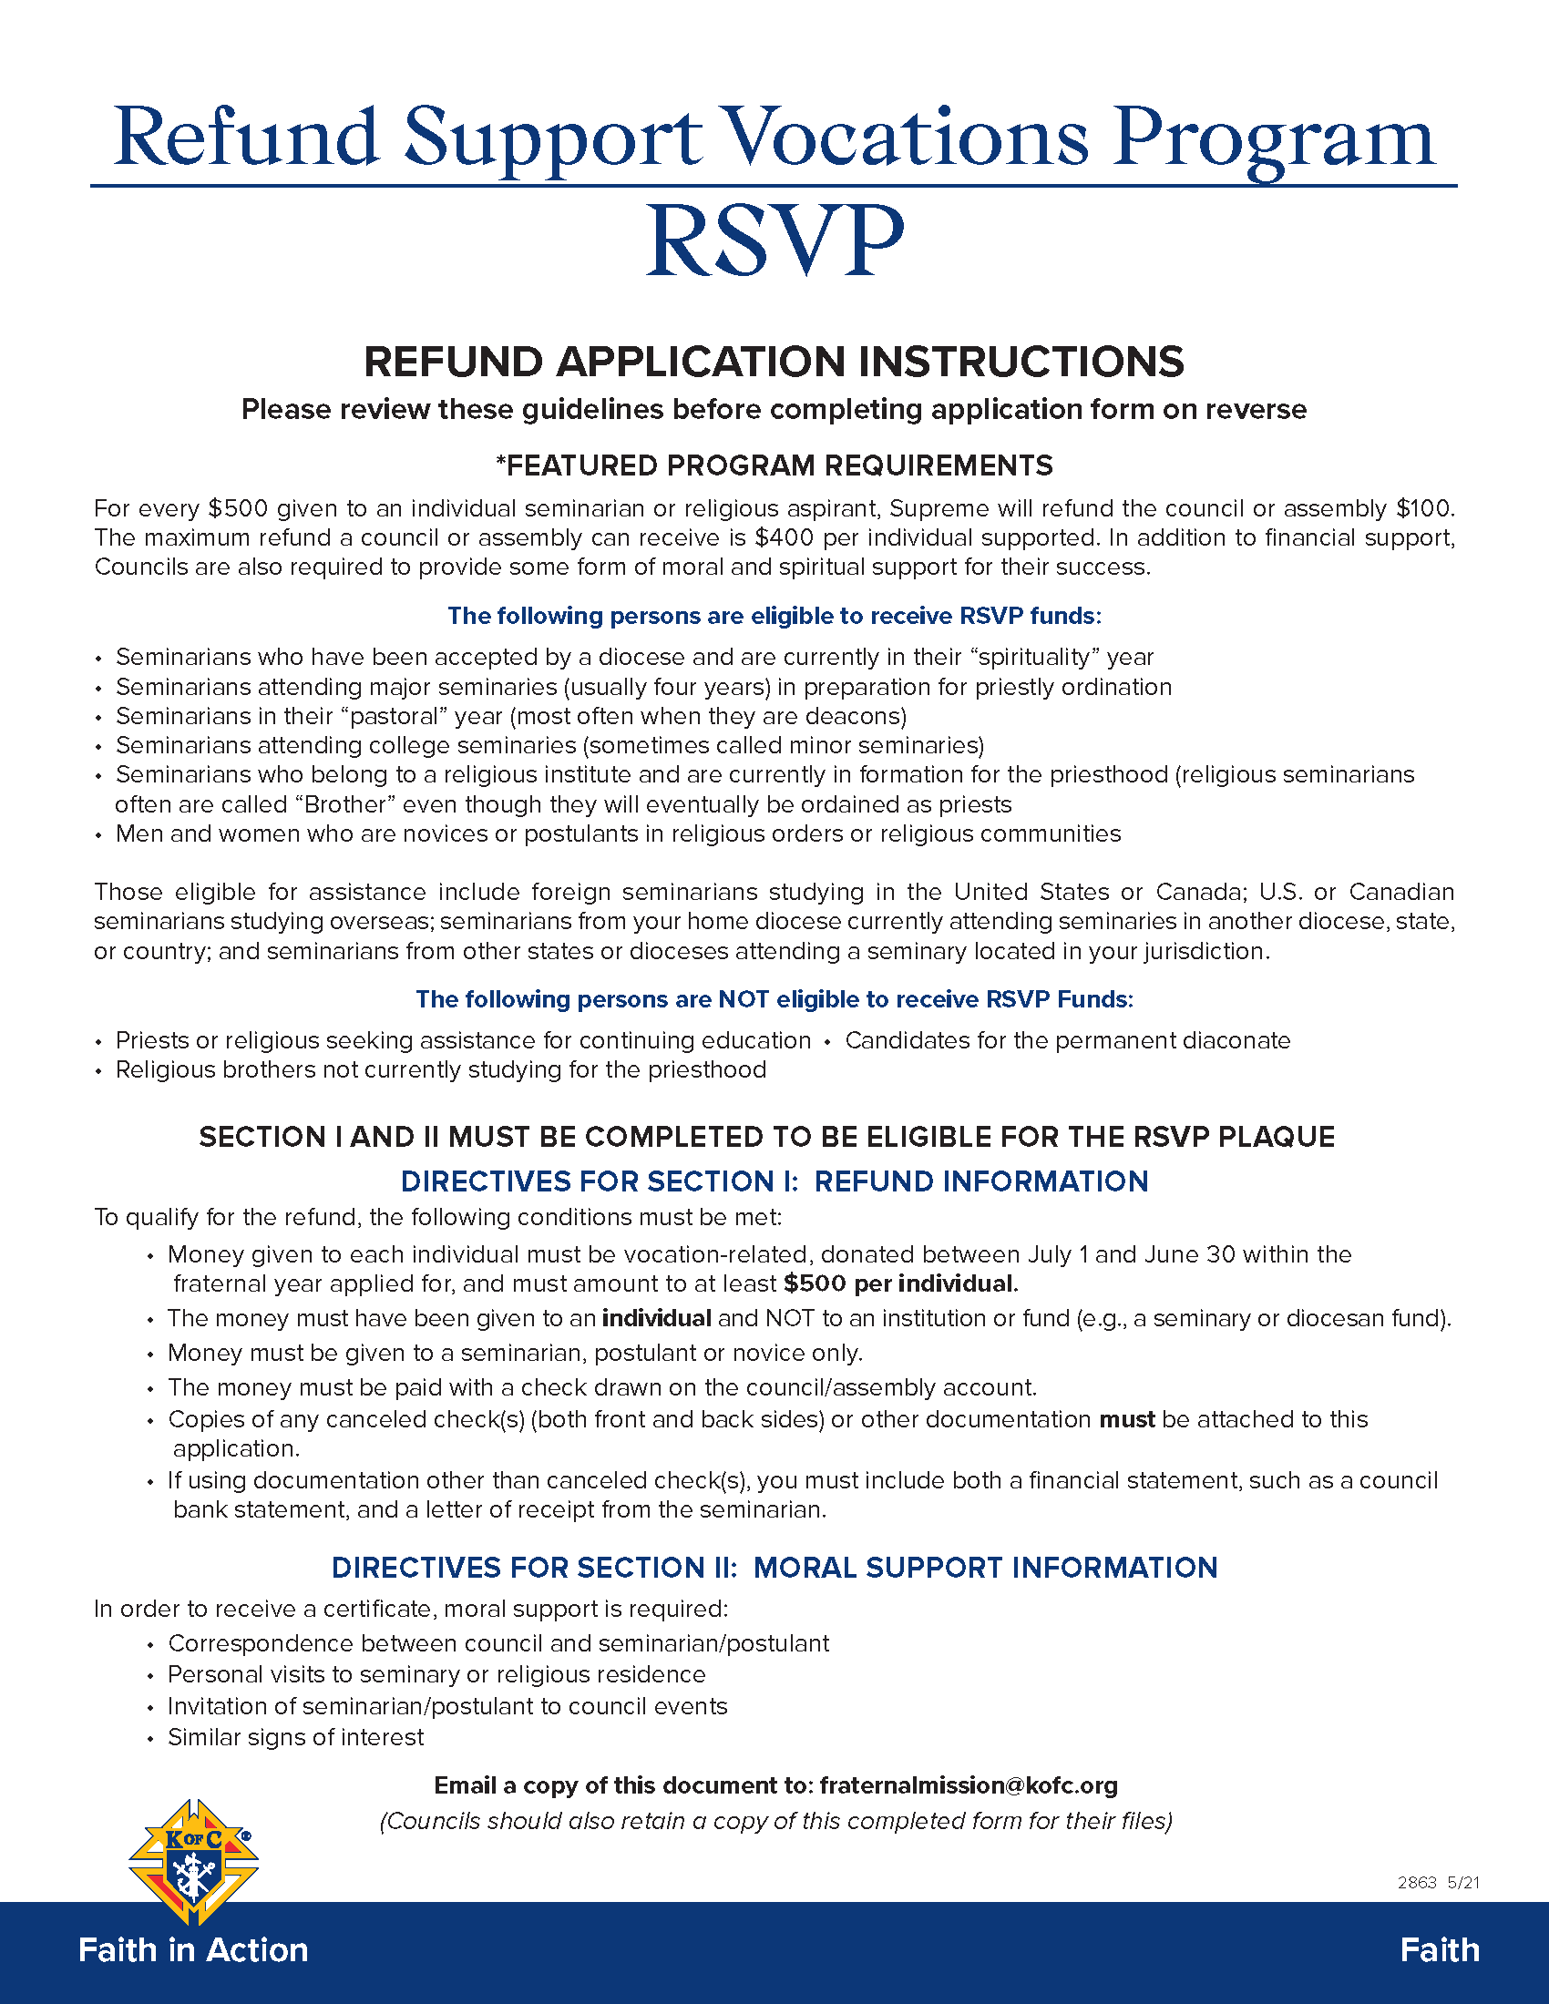
RSVP

Slide 9
RSVP
For More Information Contact:
Jerry Hayes
Membership Information/Communication Director
416-499-2141 or 647-515-2141
jerryhayes@bell.net
communicationdirector@ontariokofc.ca
www.ontariokofc.ca

