Slide 1
Ontario State KofC GENERIC E-MAIL
LOG – IN and SET UP a permanent password
(It only takes 6 steps to do this process.)
UPDATED July 5, 2022

Slide 2
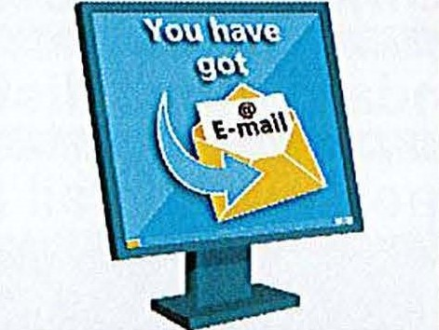
Ontario State Generic Emails: “Why it is important?”
It is important to start using Ontario KofC emails when they are assigned to you. All MIO’s, Directors, District Deputies are assigned Emails. Council Grand Knights and Financial Secretaries may participate if they wish to.
Having common xxxx@ontariokofc.ca emails will:
Make it easy for others to communicate with you. For example, they will know if they want to email Grand Knight, all they have to do is add the councils number to the email: i.e. GK1234@ontariokofc.ca
Privacy issues make it important not to use your personal email. This is for your own protection as well as the security of sensitive information which maybe sent to you.
If there is a change in position, then the password can be quickly reset by the State Office for the new officer and he will have access to the previous emails.
Will allow the state office easier communication with all Councils through a standard email distribution list. Often members change their personal email (i.e. from Bell to Rogers) and do not notify Ontario State office.

Slide 3
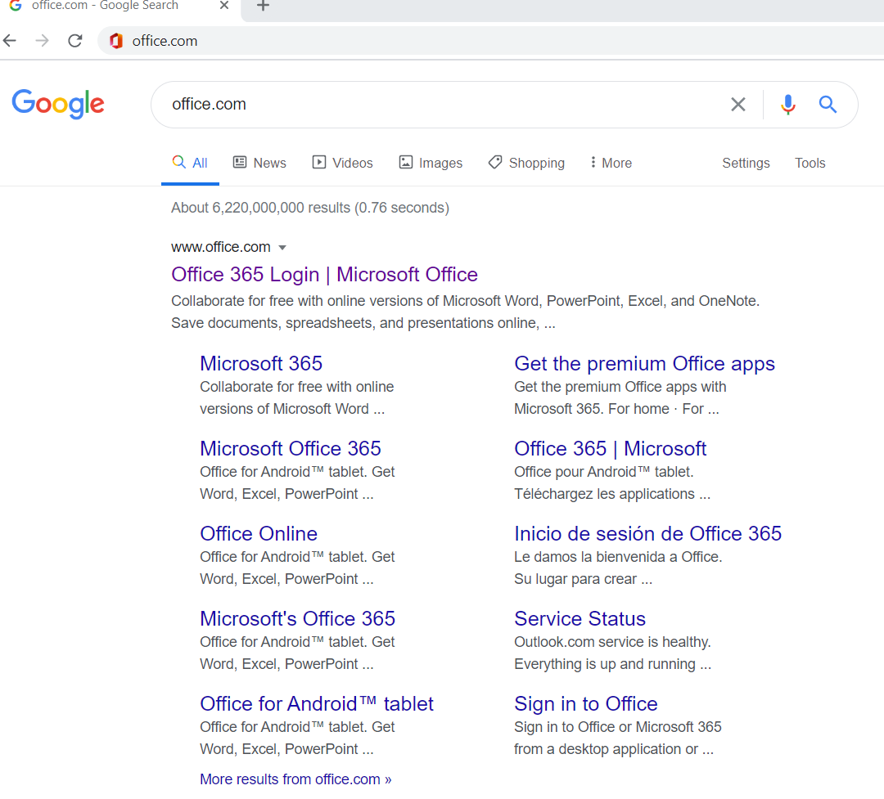
STEP 1
Open a browser (Google Chrome, Mozilla Fire Fox, Microsoft Edge) and type office.com or you
can click this link https://office.com/
Click

Slide 4
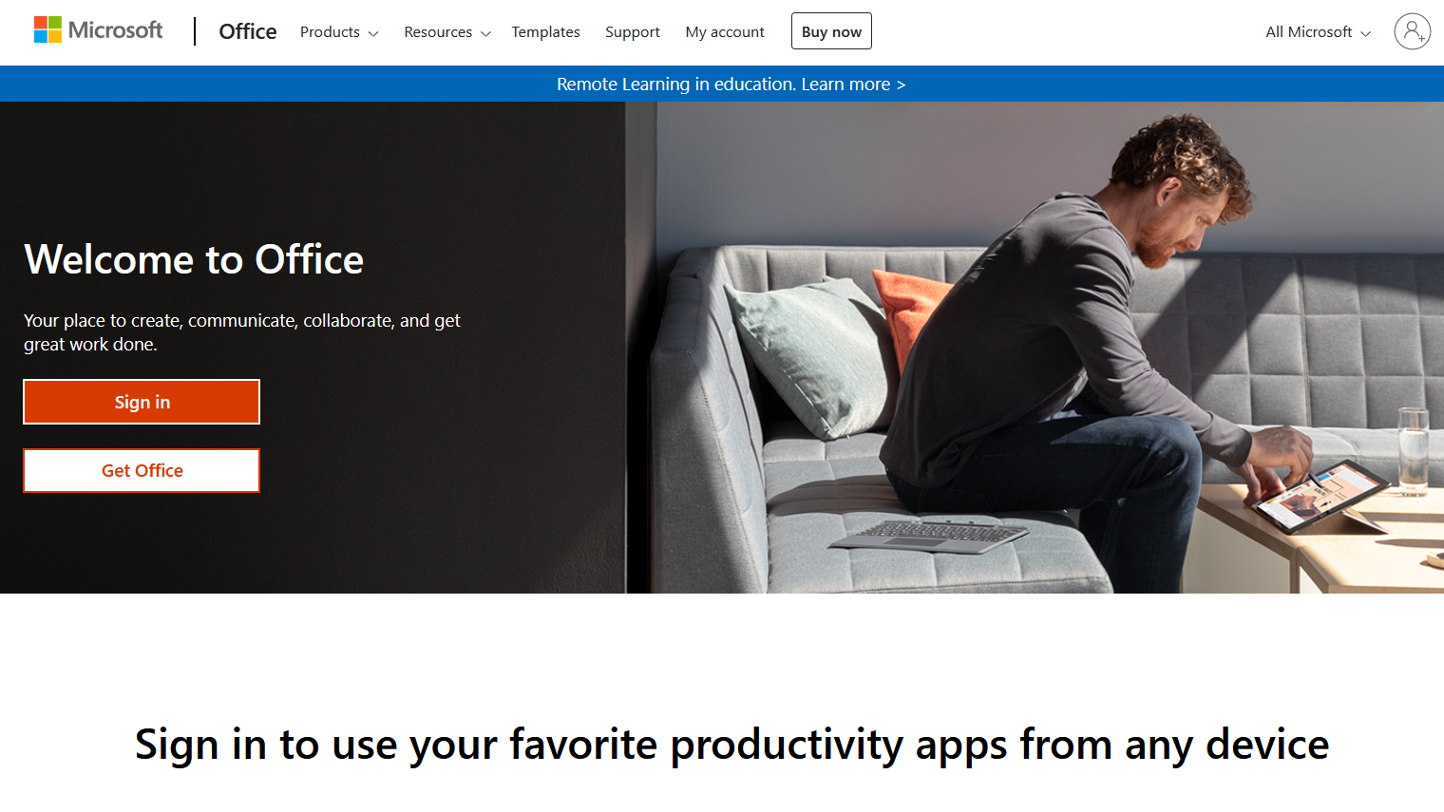
STEP 2
Click Sign in

Slide 5
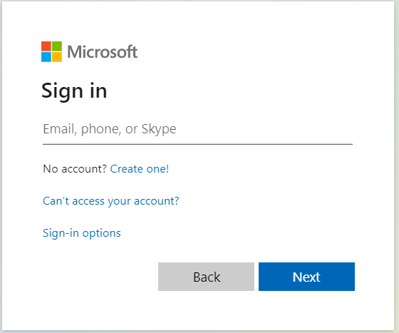
STEP 3
Enter your generic assigned email address
GKxxxx@ontariokofc.ca
FSxxxx@ontariokofc.ca
DDxx@ontariokofc.ca
x stand for council number for GK and FS
x stand for district number for district deputy
Type your generic email address here on this line

Slide 6
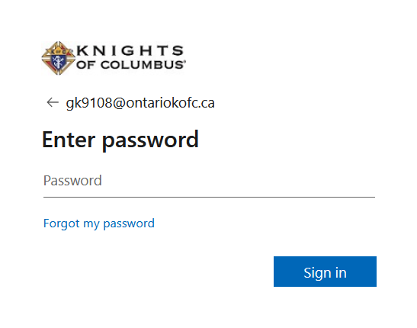
STEP 4
Enter temporary password provided by State Office. Please call State Office at 1800.759.0959 or 905-388-2731
Enter temporary password
Click to Sign in

Slide 7
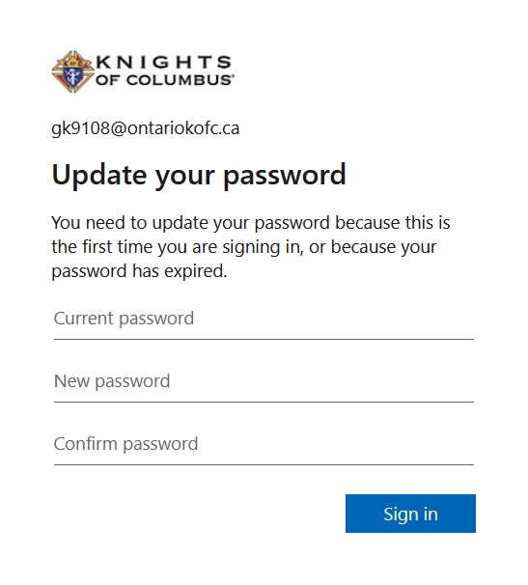
STEP 5
Update password
Type temporary password
Set up permanent password
At least 8 characters or more,
Mix of big & small letters, numbers
or special characters
Re-type permanent password
Click to Sign in

Slide 8
When you see this box,
Just click the “x” to close.

Slide 9
Click Outlook app
Notes:
Once you completely logged in to your state email account, you will be directed to the main page with a “Good morning” or “Good afternoon”.
To check emails, send or receive emails, you need to click the “outlook” app.
If you want to see all the apps included in this account, you can click “All apps”.

Slide 10
Click X to close this box

Slide 12
Click and it will show the account details of the email address. For DD it will appear
D9 inside the circle,
District Deputy 99
DD99@ontariokofc.ca

Slide 13
STEP 6
Send a
“test email”
ani@ontariokofc.ca o mario@ontariokofc.ca or
stateoffice@ontariokofc.ca or anna@ontariokofc.ca
Test email
Click to send

Slide 14
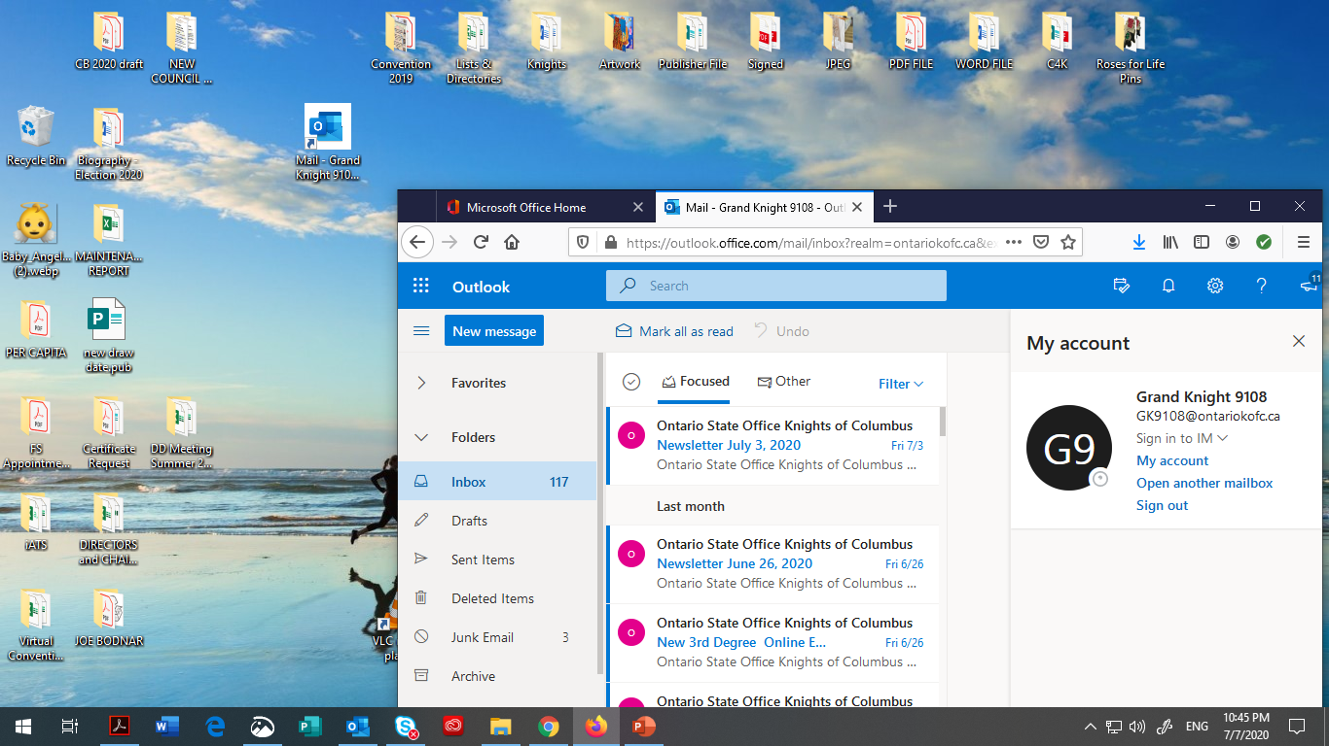
How to create shortcut
to your desktop
Click the padlock, drag and drop to your desktop
Here is your outlook icon

Slide 15
Great news! As officer of your council (Grand Knight, Financial Secretary, District Deputy, MIO’s), you can set up a virtual meeting for your council using Microsoft Teams for free! That is if you are signed-in to your generic state email account (ex. gk@ontariokofc.ca). Brothers, it is not too late for us to become tech-savy. I encourage you to watch the tutorials to find out more about TEAMS. Please click the link below.
Microsoft Teams video training - Office Support
Notes:
Microsoft Teams is included in your generic/state email account. You can use this app to set up a virtual meeting with your council.
You can download the Microsoft Teams app and install it in your desktop.
Watch the video training to learn about Microsoft teams.

Slide 16
Stay healthy and God bless ☺ THE END

