Slide 1
KNIGHTS OF COLUMBUS - ONLINE MEMBERSHIP – Joe Mathews Online Membership Director

Slide 2
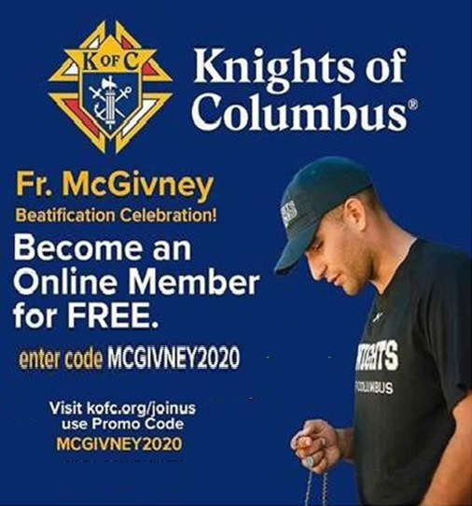
The Knights of Columbus Online Membership
JOIN ONLINE FOR FREE (UNTIL FURTHER NOTICE) QUOTE CODE MCGIVNEY2020

Slide 3
The Knights of Columbus Online Membership
ONLINE MEMBERSHIP REQUIREMENTS
Every man who joins online needs to access kofc.org/joinus from a compatible device, preferably his own, personally completing the online application, testifying to all the attestations, and submitting the online application himself.

Slide 4
The Knights of Columbus Online Membership
ONLINE MEMBERSHIP PROCEDURES
The member must use his own valid email address when completing the online application.

Slide 5
The Knights of Columbus Online Membership
APPLICATION PROCESS
Access https://www.kofc.org/joinus
Complete the first page of the application.
A verification code will be sent to the email address provided thus allowing the candidate to continue completing the application form.

Slide 6
The Knights of Columbus Online Membership
APPLICATION PROCESS (continued)
Supreme will soon be making available a training deck on the application form and its various fields, such as:
The Agent Referral Code (only used by the Agents)
Preferred Local Council (Assigned List/Prospect Tab)
Member Referral Number (Proposer)

Slide 7
The Knights of Columbus Online Membership
APPLICATION PROCESS (continued)
Former Member (enter the Council number)
Previously Held Insurance
Parish Name and Address (used to assist in assigning a local council for the e-member to consider joining)
Promo Code – MCGIVNEY2020

Slide 8
The Knights of Columbus Online Membership
ONLINE MEMBERSHIP LISTS
List of Unassigned Members
List of Assigned Members
State Online Membership Roster
Online Exemplification List from Supreme
List of Potential New Members (Referral Program)

Slide 9
The Knights of Columbus Online Membership
LIST OF UNASSIGNED ONLINE MEMBERS
Preferred Council not indicated on the application
Email sent to State identifying the new member
Email sent to DD/MIO based on member’s address
Prospective Council identified by parish and address
Council contacts State to move member to Prospect List

Slide 10
The Knights of Columbus Online Membership
John Doe has joined the Knights of Columbus through the eMembership initiative and is interested in transferring to a local council in your area. John Doe 123-4567 My Street, My City, ON, L9Z 3T7, CA 905-123-4567 johndoe@gmail.com Parish Information: St Anthony (My City, ON)

Slide 11
The Knights of Columbus Online Membership
LIST OF ASSIGNED ONLINE MEMBERS
Preferred Council indicated on the application
Email sent to State identifying the new member
Email sent to the DD based on the council number
The new member can be found on the Council’s Prospect List by using the Prospect Tab (accessed by the GK and FS)

Slide 12
The Knights of Columbus Online Membership
John Doe has joined the Knights of Columbus through the eMembership initiative and is interested in transferring to Council 12345. John Doe 123-4567 My Street, Mycity, ON, L9Z 3T7, CA 905-123-4567 johndoe@gmail.com Parish Information: St Anthony (Mycity, ON)

Slide 13
The Knights of Columbus Online Membership
STATE ONLINE MEMBERSHIP ROSTER
This list consists of the online members on both the Assigned and Unassigned lists along with the online members who have been moved off of these lists and into the Ontario State e-membership Council No. 98055.

Slide 14
The Knights of Columbus Online Membership
ONLINE EXEMPLIFICATION LIST (SUPREME)
This list consists of all the online members and candidates who attended one of the many online exemplifications hosted by Supreme during the fraternal year.

Slide 15
The Knights of Columbus Online Membership
ADDING NEW MEMBERS TO YOUR ROSTER
Online members on your Prospect List can be added to your roster by simply entering the Exemplification date
Online members not on your Prospect List requires the council to use either a Form 100 or the Candidate Tab (online Form 100)

Slide 16
The Knights of Columbus Online Membership
UPDATES
This year 60% of new members are online members
27% of online members have joined a Council
There are no annual dues
Online membership renewed automatically on Jan 1st
A new membership card is issued annually

Slide 17
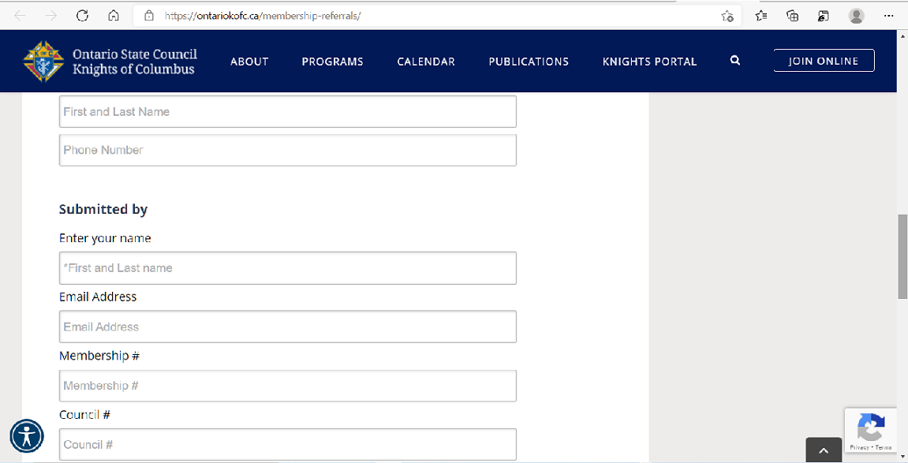
The Knights of Columbus Online Membership
MEMBER REFERRAL INITIATIVE

Slide 18
The Knights of Columbus Online Membership
RESOURCES
Candidate Tab video
Prospect Tab video
Online Application Training Deck
http://www.kofcmembership.com
https://kofc.org webinars

Slide 19
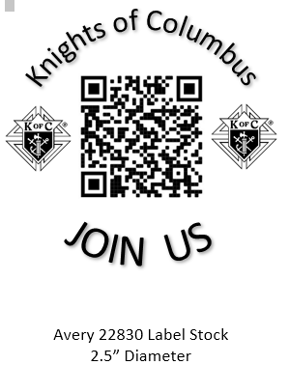
The Knights of Columbus Online Membership
eMembership Recruitment Resources To assist you with promoting online membership, Ontario State Council is providing you with a package of promotional material, which includes, posters, label template for buttons and bulletin ads. All material is in English or French and you can translate it into any language of your choice.

Slide 20
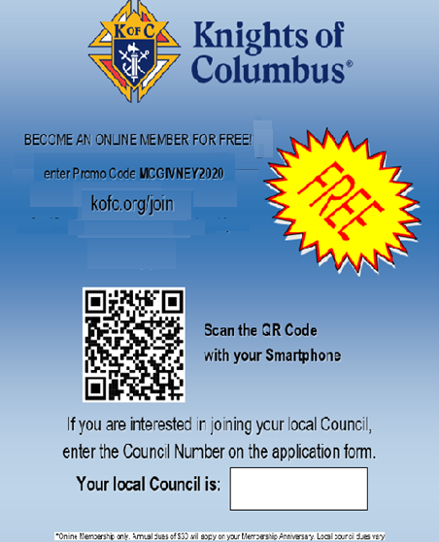
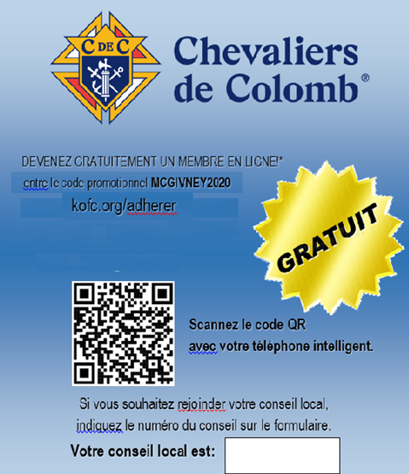
The Knights of Columbus Online Membership

