Slide 1
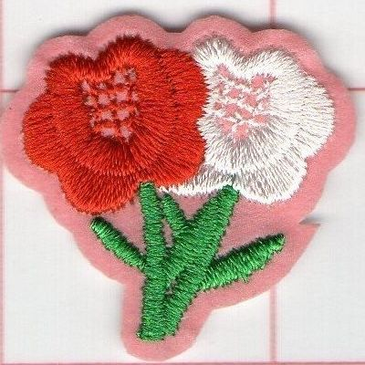
Life PROGRAMS 2022 - 2023
Brother Alex Schadenberg
Life Director
Knights of Columbus Ontario State Council
Lifedirector@ontariokofc.ca,
519-851-1434 (cell)

Slide 2
Life Director – Alex Schadenberg
Life Programs: March for Life, Ultrasound Program, Special Olympics, Novena for Life, Pregnancy Center Support, Mass for People with Special Needs, Christian Refugee Relief / Holy land and Persecuted Christians, Silver Rose.
Ontario programs: Seniors and Widows. Roses for Life.
Alex Schadenberg, lifedirector@ontariokofc.ca
519-851-1434 (cell).

Slide 3
Life Programs.
Many councils are having difficulty existing.
I am urging every District Deputy to promote a few simple Life Programs to enable their councils to thrive.
These programs are:
March for Life
Pregnancy Center Support
Roses for Life
Other important programs include:
Special Olympics
Christian refugee relief.

Slide 4
March for Life
The National March for Life is supported by Supreme.
The March for Life will be Thursday May 11, 2022.
We urge councils and districts to promote or sponsor buses to the National March for Life.
The March for Life Youth Conference needs the financial support of councils.
We will continue to ask members to volunteer at the March for Life to distribute signs and ask as Marshals.
Brother Chris Naus (Chairman)

Slide 5
Pregnancy Center Support
We can help to change hearts and minds concerning abortion by providing help for pregnant women and their child.
Councils can provide material, financial, labour and other volunteer support for pro-life pregnancy centers.
Many communities have a Crisis Pregnancy Center (CPC), Birthright or home for “unwed mothers.”
Toronto has several services such as the Sisters of Life and Aid to Women (which is next door to an abortion clinic).

Slide 6
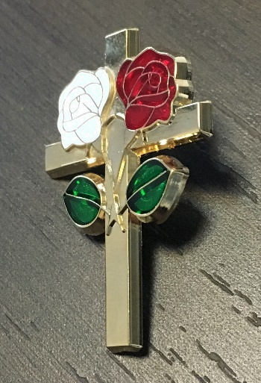
Roses for Life
The Roses for Life program offers a rose sticker and rose pins that are available for distribution.
Traditionally the Roses for Life program was done on Mother’s Day. Many councils are unable the Roses for Life program on Mother’s Day.
Councils are urged do the Roses for Life program on Life Chain weekend (October 2, 2022).

Slide 7
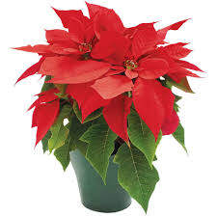
State Priority – Widows program
The Widows program shows the family of our deceased members that we have not forgotten them.
By bringing a Poinsettia / gift with a Christmas card to a widow, it shows our widows and their family that we care and that we are keeping them in our hearts and prayers.
It is an easy program to implement and will makes a great difference in other people’s lives.

Slide 8
State Priority - Seniors program
Councils are urged to visit or contact (call or visit) seniors and widows in their council or parish.
There are many lonely older members or widows.
Councils can casually visit or contact (call) their seniors and widows because they are important to us.
The Compassionate Community Care visiting training program exists to provide visitor training at no cost.
Alex Schadenberg (Chairman) 519-851-1434
Lifedirector@ontariokofc.ca,

Slide 9
Sponsor Brother’s Marcel Lemmen and Alex Schadenberg in their run for CCC.

Slide 10
Special Olympics (featured)
Brother Joe is committed to the Special Olympics program and your councils should share his zeal.
Joe Mathews has a special presentation for Special Olympics.
The Knights of Columbus has been involved with Special Olympics since its inception. We need to give more attention to this program.
Joe Mathews (Chairman) joemathewskofc@gmail.com

Slide 11
Christian Refugee Relief
Christians are at risk in areas all around the globe. The Knights of Columbus has responded with humanitarian assistance, primarily in Iraq, Syria and the surrounding region. Councils will aid this cause by collaborating with their parishes to spread awareness and raise funds to help these Christians and those in their care.
This has been a very successful program.
I urge you to continue working with Hikmat Dandan.
Hikmat Dandan (Chairman) 416-893-8060
knightsofcolumbus@hotmail.com

Slide 12
Ultrasound program
In Ontario we need: A pro-life physician who works with crisis pregnancy centers, and within a medical clinic that has an Ultrasound technician.
The program requires a council/councils to cover half the cost of the Ultrasound machine. Supreme pays the other half. The application must be approved by: Supreme, State and the local Bishop/Diocese.
Alex Schadenberg (Chairman) alex@epcc.ca
lifedirector@ontariokofc.ca

Slide 13
Mass for People with Special Needs
Councils are asked to sponsor an annual mass for people with special needs.
We encourage councils to bring people with special needs to mass on Sunday. People with special needs often have difficulty going to mass based on mobility issues.
People with special needs often feel uncomfortable in the faith community. We need to be a welcoming presence.

Slide 14
Silver Rose
Ontario has a Silver Rose to be used for council special events.
Supreme sends Ontario a Silver Rose for distribution over a four week period.
The Silver Rose program demonstrates the unity between Knights of Columbus in Canada, US and Mexico through prayer services promoting the dignity of all human life and honoring Our Blessed Mother.
Contact Dennis to schedule the Silver Rose in Ontario.
Dennis Mailloux (Chairman) dennisfm@hotmail.com

Slide 16
Life Director
Brother Alex Schadenberg
Ontario State Council
Life Director
lifedirector@ontariokofc.ca
519-851-1434 (cell)

