Slide 1
District Deputy Expense Forms
Supreme and State

Slide 2
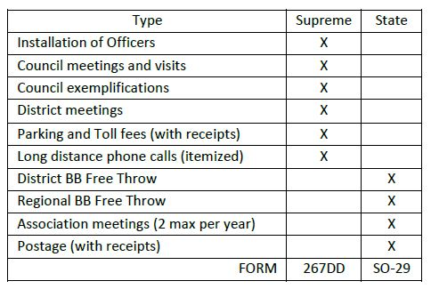
Supreme & State forms summary
See State memo titled “District Deputies Expense Account Procedures”
Which expense form to use? See chart & also found on document mentioned
Note: Nothing fourth degree related

Slide 3
Supreme expense form
Supreme expense form 267DD (EN & FR)
Must complete the form in full showing all math calculations and complete all your personal information
Supreme encourages for each quarter but a minimum of $25 but within the calendar year (6 months)
Submit this form to the State office for the State Deputy’s approval and signature (not to Supreme office) at stateoffice@ontariokofc.ca
Final deadline is July 15th each year so to the State Deputy by July 5th.

Slide 4
State expense form
State expense form SO-29 (EN & FR)
Must complete the form in full showing all math calculations and complete all your personal information
State Treasurer encourages for each quarter but a minimum of $20 but within the calendar year (6 months)
Submit this form directly to the State Treasurer for approval and signature
Email: statetreasurer@ontariokofc.ca
Final deadline July 30th each year

Slide 5
David Gelinas State Treasurer
State Treasurer
statetreasurer@ontariokofc.ca
(226) 280-5086

