Slide 1
College Councils Recruitment
Micah Remedios
New College Council Development
Notes:
Introduce yourself
Let them know why you are here today ( to give some insight on College councils)
Requesting your help to introduce college counsels and try and form new ones.

Slide 2
Why Recruitment?
You are the brand of the knights of Columbus on your College Campus – Supreme knight Carl Anderson
Notes:
The youth are the future
We act as brand ambassadors
One day we will be up here in your shoes and wouldn’t it be great to say you started as a college council

Slide 3
What is a college council
Is a Knights of Columbus unit formed at a college or university to meet the needs of students and their campus community
In a unique way our councils create an environment for Catholic men to discern their vocation and become the best version of themselves.
Supported by other men who share their faith and passion for service, fraternity, and socialization,
Notes:
- We are trying to also start councils within districts and city’s that do not have a college attached
- We want to do this to achieve the ever changing needs of the youth that want something more with connecting their faith values

Slide 4
Common Objections to Membership
Not enough time
No required time commitment
Schedule may change down the road, can become more involved then
I don’t know enough about the Knights
Create an elevator pitch about the Knights and your council
Just for old guys
Well, clearly not…
150 college councils in North America, 5,000 college Knights
Notes:
We want to encourage

Slide 5
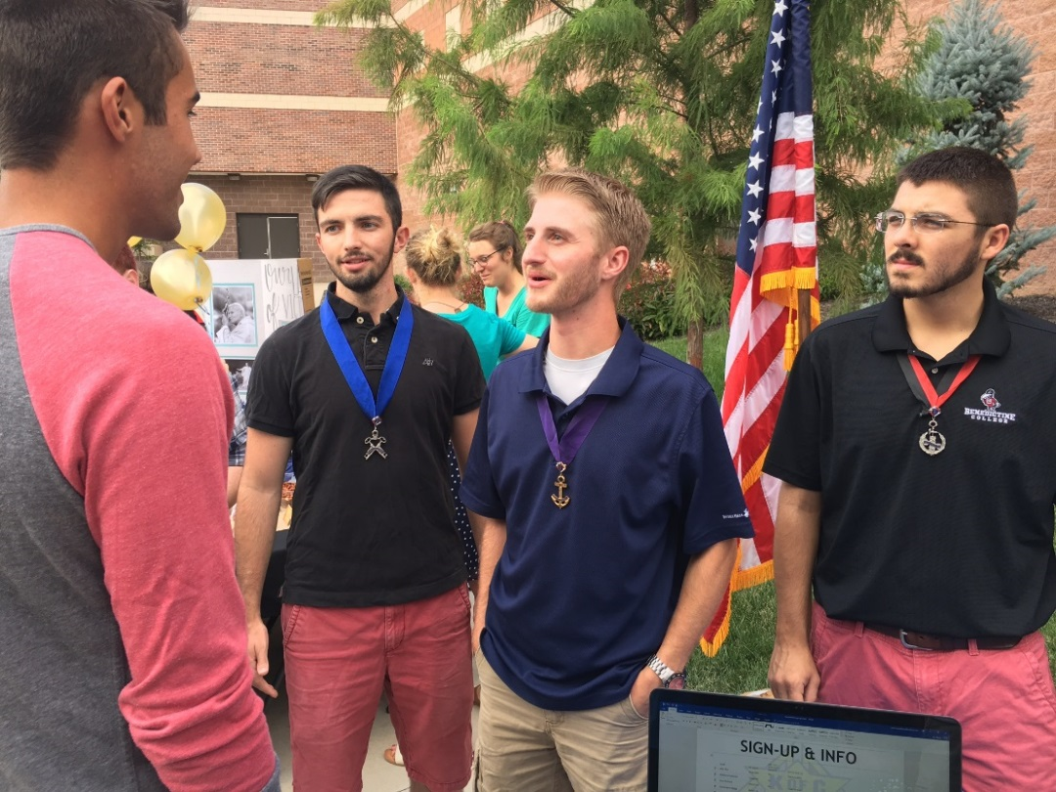
How you can help
Identify
Graduating members from the Squires programs or in University.
Active men from the age of 19-35
Meet
Meet with each graduating member to discuss options of joining and forming a group
Establishing
University Contacts to pass them on to us

Slide 6
What we need to form a new council
Have 20 active men to take a first degree or transfer in
Hold an Election of Officers
Appoint a Chaplain
Appoint a Financial secretary (cannot be a student)
Notes:
These are just a few things that we need to start a Council
One of the biggest aspects is appointing a Financial Secretary as they cannot be a Student

Slide 7
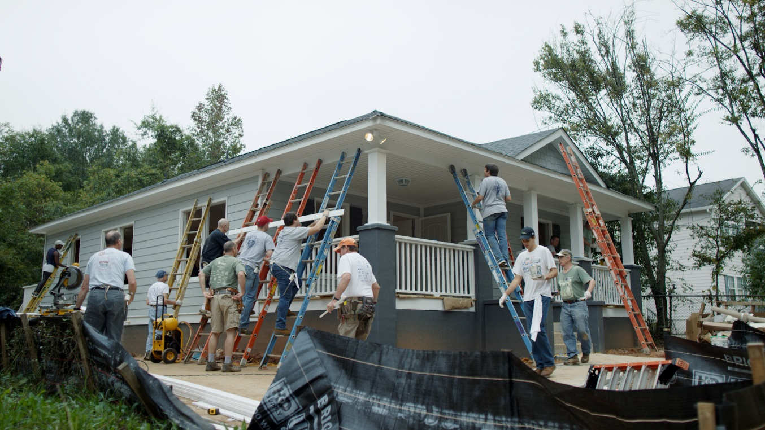
How is it beneficial
Creates leaders
Bring young men towards the faith
Forms lasting friendships
Networks with peers
Access to the Life Insurance portfolio

Slide 8
How it can help you
Helps the community
Assist your District and the councils
Strengthen your membership retention
Grows your membership
Entry point into the Knights of Columbus

Slide 9
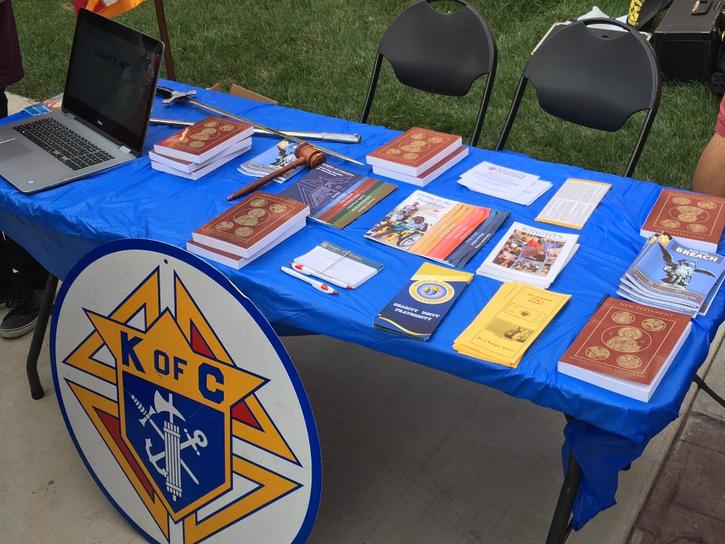
Incentives
All membership incentives as per the calendar year apply to the College Council Portfolio

Slide 10
Notes:
This is just a brief map. The little yellow or blue dots represent the states and provinces that have youth councils. Currently Ontario has 1 youth council and by the end of the year we want to have 4
We need your help to achieve this

Slide 11
Youth are the Future
Notes:
Youth are the future, one day I hope to be sitting in your seats.
Hopefully together we can inspire more young men to join and be active in the Knights.

Slide 12
Questions
Micah Remedios
E: micah.remedios@me.com
P:647-456-3192

