Slide 1

Information Session for 50/50 on-line Raffle
Jaime Libaque, FDD, PGK, PFN
Jaime.libaque@rogers.com
Cell (416) 456-7084
“ Think of the possibilities..”
Notes:
We have done well but it’s time to take a critical view of the future….

Slide 2
INFORMATION session but NOT a full Training Session
Notes:
Prayer for the Holy Innocents
Message from SD DAVID PETERS: MCGIVNEY2020 code for free membership expires in three days, on Dec 31.

Slide 3
Background on the 50/50
Nov 2020 announcement of CHANGE for 2021: New On-line 50/50 Raffle instead of past paper-based lottery
Dec 2020 invited selected Councils to participate in a Pilot Jan-March 2021
  Sault Ste Marie, Sudbury, Elliot Lake
  Orillia, Midland, Barrie
  Guelph, (Kitchener, Cambridge)
      Village Media (Marketing company) has market presence in those areas
Notes:
Summer 2020 => researched options for 2021 Lottery
=> selected two professional companies with experience in on-line fundraising
Our KOC 50/50 will be professionally run

Slide 4

What is the 50/50 and Why?
The 50/50 is one of the traditions of KOFC at meetings and events
3 tickets for $5
Arms length for $20
FUN….SIMPLE…PROFITABLE

Slide 5


WHY? 50/50 is more profitable
than Lottery
Lottery
50/50
Prize board $500,000
(67%-74% of sales)
High fixed costs
( up to 100 K$)
Net profit 15%-19%
Prizes 50% of sales
Lower fixed costs
Net profit 30%

Slide 6
How can Councils benefit?
Participating Councils will have a share from the net-profits, in proportion to their sales
By spreading the fixed costs among many Councils, it makes it easier to participate

Slide 7
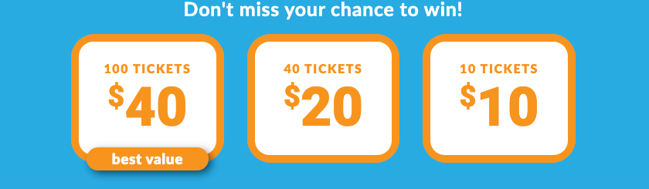
How will it be implemented?
On-line 50/50 is Simple
Unique web link provided for each Council
Step 1 : click on the link to display a buying page, for example:
100 tickets
40 tickets
15 tickets
Notes:
Page 5/23 from Ascend powerpoint

Slide 9
How will it be implemented?
On-line 50/50 is Simple
Step 2 : buyer selects price points and is directed to a payment page, for example:
  Name
  E-mail address
  Credit card information

Slide 10
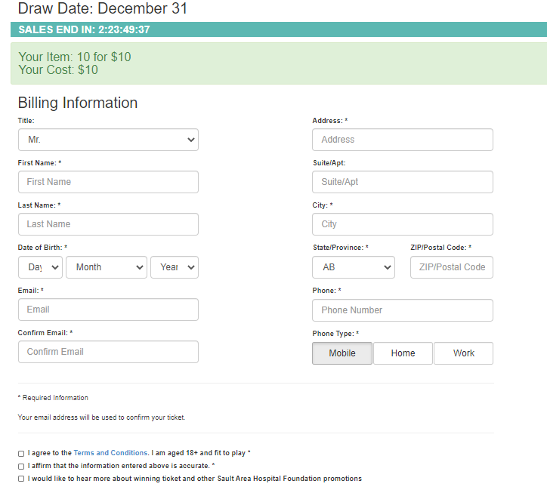
Notes:
Email is important
DOB to verify age
Address to verify residency

Slide 11
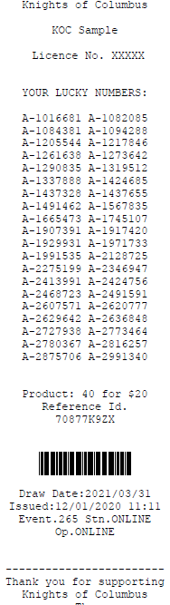
On-line 50/50 is
Simple
Step 3 : an e-mail with the ticket numbers is sent to the buyer, for example:

Slide 12
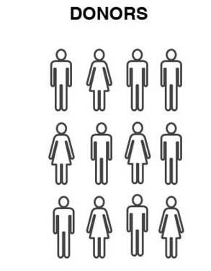
How can Councils participate?
Council
web link
Secure Merchant platform
OSC bank account
Village Media website
OSC website
Higher Council sales =>
higher returns for the Council

Slide 13
How can Councils participate?
Use smart phones, Tablets, Laptops
  Promote using email, social media and Council/Parish website (if possible)
  Promote local charity recipients (e. g. Church project)
Hand-held devices and printers available for rent (additional cost to each Council)

Slide 14
How will it be advertised?
Local Village Media website
Local Councils to use traditional donors and social media tools
Ontario State will have a web page

Slide 15
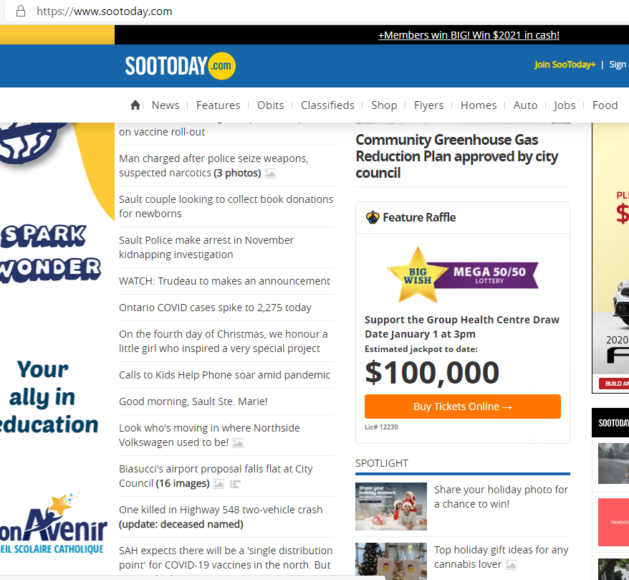

Slide 16
Frequently Asked Questions
Q: Are the transactions secure and is the privacy of consumers protected?
A: Yes. The regulator (AGCO) requires proof that technology solution is both secure and protects privacy. The contracted company (Ascend) is registered with the AGCO

Slide 17
Frequently Asked Questions
Q: Will Councils have a share of the profits ?
A: Yes. We will follow the past practice of the paper-based lottery and share the net profit with participating Councils (proportional to their sales)

Slide 18
Frequently Asked Questions
Q: Do Councils have to participate throughout the year?
A:No. Participation is optional but encouraged as a practical means of raising funds.

Slide 19
Frequently Asked Questions
Q: Can Councils operate their own on-line 50/50?
A:Yes. However they would have to obtain the AGCO license and cover all fixed costs (license, technology solution, etc). The net profits maybe lower

Slide 20
Frequently Asked Questions
Q: When will training take place?
A: Estimated timeline is Jan 13-18. Will keep participants informed.

Slide 21
Frequently Asked Questions
Q: Can people from outside Ontario buy tickets?
A: No. The AGCO requires residence in Ontario.

Slide 22
Frequently Asked Questions
Q: How often will the 50/50 run in 2021
A:Quarterly. That is 4 times in 2021
Q: Are hand-held devices mandatory?
A: No. The preferred way of selling is through phones, tablets, laptops

Slide 23
Frequently Asked Questions
Q: When will it be rolled out across Ontario?
A: After the Pilot is completed.
    Jan – Mar: 7 markets Sault Ste. Marie, Sudbury, Elliot Lake, Guelph, Orillia, Midland, Barrie
    Apr – Jun: 14 markets, About 100 Councils
    Jul – Sept : province-wide
    Oct – Dec: province-wide

Slide 24
Frequently Asked Questions
Q: Are there plans to work with other marketing companies?
A: Yes. It’s under consideration depending on the results of the Pilot. Currently looking for marketing companies operating in Southwestern Ontario and Ottawa areas

Slide 25
Frequently Asked Questions
Q: Concern that local Councils may not be able to promote KOFC in malls as with the paper-based lottery.
A: During COVID restrictions the on-line solution allows us to continue promoting the KOFC. When restrictions are lifted, going to the malls and selling at Churches and events is possible.

Slide 26
Frequently Asked Questions
Q: Concern that State overhead and fixed costs of 50/50 would lower the net profit for Charities.
A: No. On the contrary, the 50/50 fixed costs are lower than the paper-based lottery. For example, costs of printing and distribution of tickets will not be incurred in the 50/50

Slide 27
Frequently Asked Questions
Q: Concern of competition with other organizations doing on-line fund-raising
A: Yes, there will be competition. Even with the paper-based lottery there has been competition. Councils have successfully managed to sell, despite the competition, by pointing out the Charitable purpose of raising funds.

Slide 28
Background slides

Slide 29

2020 Charities Lottery was a qualified Success
  Large Council engagement
  334 (> 60% participation rate)
  Sales 8% lower than 2019 but very good results considering COVID restrictions
  Councils experimented with social media promotions/advertisement with positive results

Slide 30
Steering Committee
Marcel Lemen, David Peters, Bruce Poulin, Denis La Salle
Project Sponsor
Bruce Poulin
Project Manager
Jaime Libaque
Ascend
Keshav Sharma
Jim Gilliom
Village Media
Rob Speers
Scott Sexmith
Knights Project team
Denis La Salle, Liane , Ani, Anna, Jaime
Authorize.net
Participating Councils (affiliates)
Participating Councils (affiliates)
Participating Councils (affiliates)

