Slide 1
F
A
M
I
L
Y
Family Director: Mario Duguay
P r o g r a m s

Slide 2
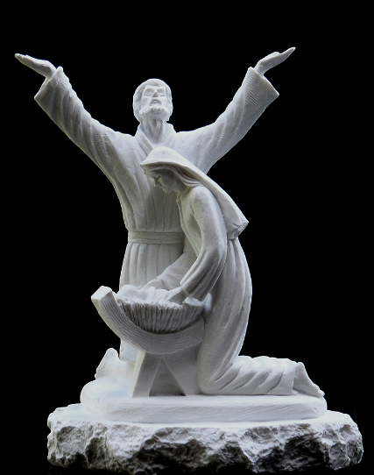
C
H
A
I
R
M
E
N
Position | Name | Home | Cell | Email | Spouse
Family Director | Mario Duguay | 613-841-3993 | 613-790-8453 | marioduguay.kofc@gmail.com | Lorraine
Food for Families | Michael Simpson | 905-873-9962 | 647-206-4752 | michael.simpson@cogeco.ca | Athena
Family of the Month/Year | Ron Hutt | 613-238-4888 | 613-859-4888 | ronhutt@rogers.com | Janine
Keep Christ in Christmas (Posada, Poster Contest, etc.) | André Cayouette | 613 837-2637 | 613 720-6167 | A.Cayouette@rogers.com | Mureille
Family Fully Alive | André Cayouette | 613 837-2637 | 613 720-6167 | A.Cayouette@rogers.com | Mureille
Family Week | Jacques Girouard | 613-837-9516 |  | jacgirouard@sympatico.ca | Agnès
Consecration to the Holy Family | Deacon Bob Rosales | 416-297-8868 | 416-346-3324 | bobrosales@rogers.com | Jeanette
Family Prayer Night -new | Jacques Girouard | 613-837-9516 |  | jacgirouard@sympatico.ca | Agnès
Good Friday Family Promotion -new | Alphonse (Bud) Duguay | 705-734-2701 | 705-305-7694 | bduguay76@gmail.com | Shirley
Deceased members headstone cleaning and prayers | David Gelinas | 226- 216-0921 |  | david4kcknights@hotmail.com | Lori
C O N T A C T

Slide 3
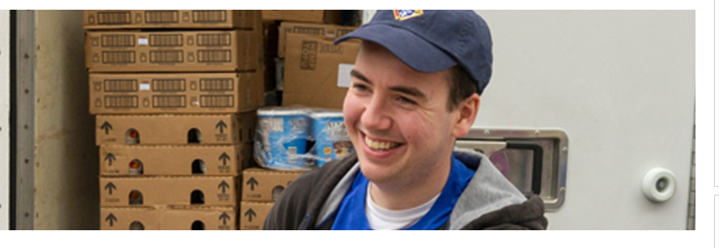
Featured Program
F
O
O
D
F
O
R
Councils are required to collect a minimum of $500 or 1,000 pounds of food for a parish or community food pantry. In addition, council must contribute a minimum of 100 total man-hours in preparation/distribution/ service of meals.
Report activity using the Food for Families Refund and Plaque Application (#10057).
Last year our goal was to increase participation of districts by 30%. We actually increased our donations by 59.4%. From $49,738 to $79,297.
Chairman: Michael Simpson
F A M I L I E S

Slide 4
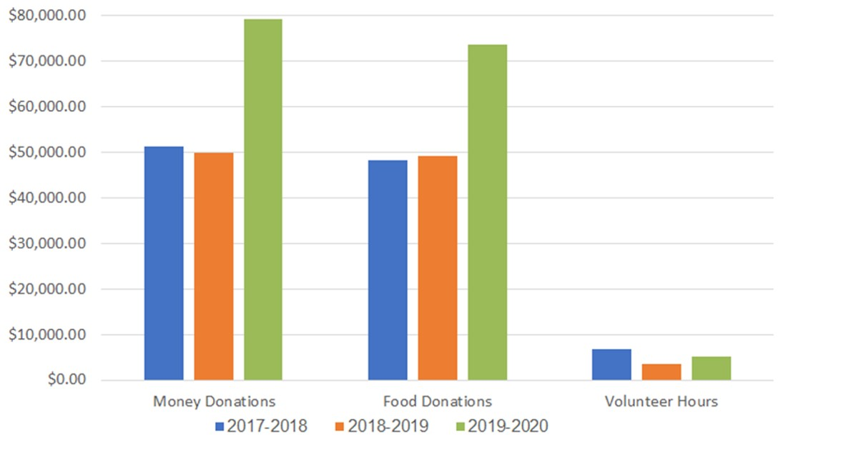
Food for Families Comparison 2017-2020
F
O
O
D
F
O
R
Prepared by : Michael Simpson
F A M I L I E S

Slide 5
Why not conduct food drive with your parishioners on Good Friday.
Get Parishioners to bring canned food to the Good Friday celebration and this will help increase participation at the same time.
After the mass ask for volunteers to assist in bringing the food to local food bank.
The next mass place an note in the bulletin thanking all of the parishioners for their contribution and provide a summary of the amount raised with the event.
We have lots of time so start working with your Pastor and promote the event in order to encourage participation.
F
O
O
D
F
O
R
F A M I L I E S

Slide 6
F
A
M
I
L
Y
Local councils should establish a committee to recognize a deserving Family of the Month and Family of the Year with potential for recognition on the international level.
Each month, the council Family of the Month committee selects one parish family that models Christian family values and visibly lives them every day.
Once a year, each participating council also selects one of the previous twelve Family of the Month winners to represent the council/parish as the potential international Family of the Year.
Chairman: Ron Hutt
Of the Month / Year

Slide 7
F
A
M
I
L
Y
Order the Family of the Month Kit through Supplies Online.
Each month, hold a committee meeting. To be selected as Family of the Month, they should meet the following criteria:
Is the family tight-knit? Does the family spend quality time together? Does the family attend weekly Mass together? Does the family pray together outside of Mass? Has the family made significant contributions to the parish and church community? Does the family serve as a model of Catholic family values?
Of the Month / Year

Slide 8
Once the Family of the Month has been selected, formally present the Family of the Month Certificate (#1843) to them.
Make sure that they are duly recognized! This could be after a Mass, at a Knights of Columbus event, or at another parish event. Enlist a fellow Knight or community member to photograph the event.
At the end of the fraternal year, prior to your state convention, select one of the previous twelve monthly winning families to represent your council and parish as Family of the Year.
Complete and submit all associated reporting forms to the Supreme Council Department of Fraternal Mission.
F
A
M
I
L
Y
Of the Month / Year

Slide 9
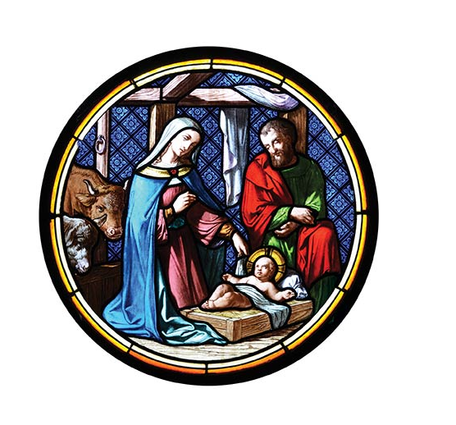
Keep Christ in Christmas
K
E
E
P
C
H
R
I
S
T
The new Keep Christ in Christmas (KCIC) program encourages councils to compel their neighbors to shift from a preoccupation with materialism to the light of Christ and the spirit of giving.
KCIC activities include whatever efforts best suit the parish and community of a particular council and do not need to originate from the Supreme Council.
Order KCIC Program resources through Supplies Online.
Chairman: André Cayouette
I N C H R I S T M A S

Slide 10
Keep Christ in Christmas
K
E
E
P
C
H
R
I
S
T
KCIC activities include whatever eﬀorts best suit the parish and community of a particular council and do not need to originate from the Supreme Council. Here are some examples:
Journey to the Inn, Light Up for Christ, Crèche or Advent Wreath Blessing, and the Christmas Poster Contest.
These programs are centered on the example of the Holy Family and the Nativity of Our Lord and Savior, Jesus Christ.
I N C H R I S T M A S

Slide 11
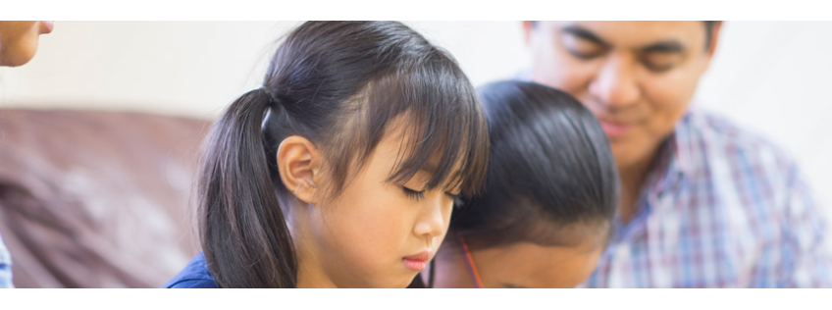
F
A
M
I
L
Y
Using the Family Fully Alive Booklet as a devotional guide, the Family Fully Alive program provides monthly themes, reflections, meditations and group projects for you and your family.
Working with your pastor, obtain his permission and recommendations on promoting Family Fully Alive in your parish and community.
Order a good quantity of Family Fully Alive Booklets (#10162) through Supplies Online.
Chairman: André Cayouette
F U L L Y A L I V E

Slide 12
Design an awareness campaign to promote the use of Family Fully Alive Booklets (#10162). Potential activities include:
Distribute Family Fully Alive Booklets (#10162) directly after Mass or catechism classes or in conjunction with your council’s Family Week Program.
F
A
M
I
L
Y
Host a Family Fully Alive Night, inviting all parish families participating in the program to come together in fellowship and community.
Be sure to plan fun family games for everyone to participate in and include a prayer and meditation portion of each evening.
F U L L Y A L I V E

Slide 13
F
A
M
I
L
Y
Dedicate a week to celebrate our families.
Councils should dedicate a special week of the year to recognize the vital importance of families as the foundation of our domestic church and to promote Catholic family values.
When choosing a week, consider factors that might aﬀect parishioner schedules such as school vacations, holidays and other local events.
Traditionally celebrated in the summer to commemorate the birth and death of Venerable Michael J. McGivney, this program can take place anytime during the year.
Order the Family Week Program Kit through Supplies Online.
Plan a schedule of fun events that aﬃrm faith and strengthen family ties. Chairman: Jacques Girouard
W E E K

Slide 14
A Rose for Our love One
F
A
M
I
L
Y
On the Sunday of Family Week Councils are to select one hospital or a care facility in their community and distribute one single rose to all patients and staff.
Chairman: Jacques Girouard
Under the current conditions, this would be a nice way to say thank you to all frontline workers for their hard work.
Include a little note on the rose with a message of hope and the name of your council. If possible, organize a mass in the hospital chapel for anyone to attend.
Have the Brother Knights and their family distribute the rose or ask your parishioners to participate.
W E E K

Slide 15
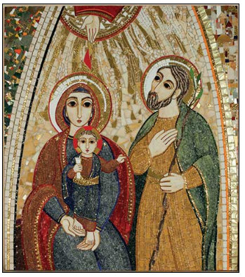
C
O
N
S
E
C
R
A
T
I
O
N
Program required to receive the Colombian Award
A Higher Purpose
Help strengthen families and revitalize our parishes. Knights of Columbus councils will invite each family in their parish to consecrate themselves to the Holy Family and to devote themselves to the ideal model of familial love set by Jesus, Mary and Joseph.
Overview
Supreme Chaplain Archbishop William E. Lori has composed a prayer through which families will come together and pray.
Councils will lead their Parishes and community to understand and offer this important and impactful prayer.
Chairman: Deacon Bob Rosales
To the Holy Family….

Slide 16
C
O
N
S
E
C
R
A
T
I
O
N
Working with your pastor, obtain his permission and recommendations on conducting a Consecration to the Holy Family in your parish.
Order a good quantity of Consecration to the Holy Family Prayer Cards (#10371) through Supplies Online.
Set a date for the consecration and announce it to your parish a month before the oﬃcial day. Distribute Consecration to the Holy Family Prayer Cards (#10371) at Masses the week before the consecration and on the chosen day. Also place a good supply of prayer cards in your church and council hall.
Following the consecration, host an event in the parish or council hall for all parish families to celebrate the consecration together!
To the Holy Family….

Slide 17
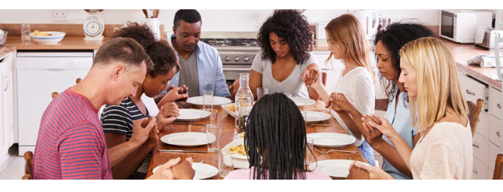
A Higher Purpose
Strengthen the bonds within our parishes and build faith-filled families. This is an opportunity for council members, families and the whole parish community to come together once a month for an evening of prayer, dinner and fellowship.
Overview
Family Prayer Night is an opportunity for children to be exposed to regular people living their faith in a casual setting. Families of council members, as well as other Catholic families within the parish and community, will gather for prayer, dinner and fellowship. Multiple groups can be formed and families are encouraged to rotate between these groups.
Chairman: Jacques Girouard
F
A
M
I
L
Y
P R A Y E R N I G H T

Slide 18
Assess interest among your council, parish, and larger community to see which families would participate. Ask your pastor for his input and suggestions on potential host families.
Build public interest before each Family Prayer Night! Promote the event in your parish and larger community.
Coordinate a schedule for upcoming Prayer Nights. The same day every month does not necessarily need to be used. That said, families who regularly attend may prefer a certain day of the week.
Make sure that Family Prayer Nights are scheduled three to four months in advance so that the families can plan ahead.
Chairman: Jacques Girouard
F
A
M
I
L
Y
P R A Y E R N I G H T

Slide 19
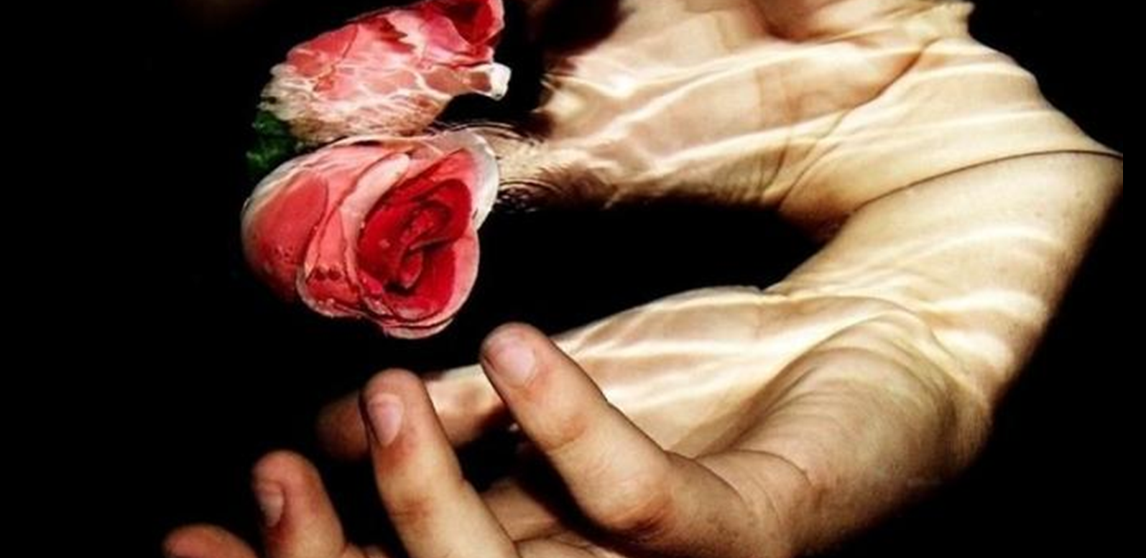
G
O
O
D
F
R
I
D
Councils will encourage participation in Good Friday services through a promotional campaign.
Chairman: Alphonse (Bud) Duguay
A
Y
FAMILY PROMOTION

Slide 20
G
Higher Purpose
O
Working with your pastor, obtain his recommendations on conducting the Good Friday Family Promotion Program.
Plan a thoughtful promotional campaign to encourage parishioners and the greater community to attend church services on Good Friday.
O
D
F
R
Incorporate a call to action to support Christians struggling in the Middle East today. Have the Christian Refugee Relief Prayer Cards (#10340) available in the parish and council hall to raise visibility of the issues aﬀecting the Middle East.
Or organize a non perishable food collection on Good Friday for a local food bank.
I
D
A
Y
FAMILY PROMOTION

Slide 21
Why: To recognize, pay tribute and pray for the repose of souls of our deceased members and to bring aid and support to our widows
How: To annually clean the headstones of our deceased members and pray for the repose of their souls. Together you recite “Lord’s prayer” in memory of deceased member. Invite widow or family member to place KC flag at head stone.
When: Anytime it is convenient for the council.
Who: Council members, Squires and parish community
Where: Local cemetery
Chairman: David Gelinas
H
E
A
D
S
T
O
N
E
CLEAN-UP

Slide 22
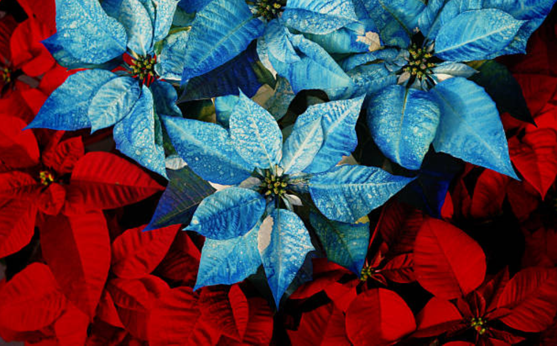
Let’s Keep our Widows in our Hearts for Christmas
C
H
R
I
S
T
M
A
S
The new Widows Poinsettia program is designed to show the family of our deceased members that we have not forgotten their contribution to the Knights.
By delivering a Poinsettia with a Christmas card to all of our Widows, it will show our Widows and their family that we still care and that we are keeping them in our hearts and prayers.
It is an easy program to implement and make a difference.
POINSETTIA

