Slide 1
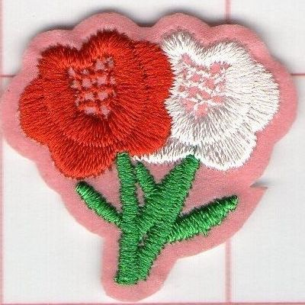
Life PROGRAMS 2019 - 2020
Brother Alex Schadenberg
Life Director
Knights of Columbus Ontario State Council
alex@epcc.ca, 519-851-1434 (cell)

Slide 2
Life Director – Alex Schadenberg
The Life theme for the next two years is caring for others, especially our Seniors and Widows.
Life Programs: Novena for Life (Required Program), March for Life (featured), Ultrasound Program (featured), Special Olympics (featured), Mass for People with Special Needs, Silver Rose Program, Pregnancy Center Support, Christian Refugee Relief/Holy Land and Persecuted Christians.
Ontario programs: Seniors and Widows. Roses for Life, Life Matters Newsletter, Pro-Life Sunday

Slide 3
Roses for Life
The Roses for Life program is an effective program for supporting local or other pro-life activities.
The Roses for Life program is often done on Mother’s Day.
In order to encourage more participation we encourage councils that do not participate in the Roses for Life program to do it on Life Chain weekend.
Life Chain Sunday will be October 4, 2020.
Anthony D’Souza (Chairman) anthony.dsouza@sympatico.ca

Slide 4
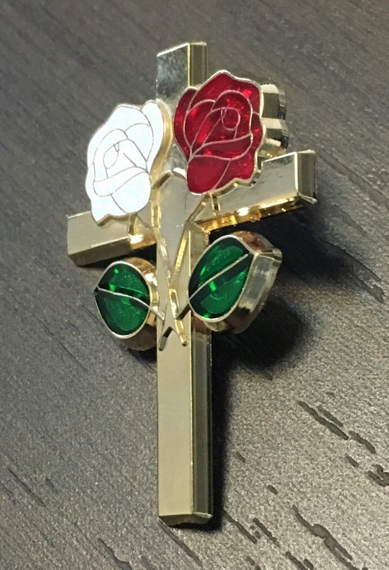
Roses for Life
We decided to change the Rose design for 2020. The new Rose design has both a Red Rose, based on our opposition to abortion and the White Rose which is the International symbol opposing euthanasia. The cost: $45 per 100 Roses + $10 shipping.
We have also produced a Roses for Life pin. The Rose pin is a item that may be sold in the parish or given to members of the council. The Rose Pin sells for $5.00 each. We sell the pin for 20 for $50 or 50 for $100 + shipping.

Slide 5
Novena for Life (required)
Brother Alex Schadenberg (Chairman) 519-851-1434
Prayer is our most powerful action for cultural change. We need to be praying for respect for human life.
The Novena for Life can be done at any time. I have scheduled the Novena for Life from Dec 4 – 12, 2019 completed on the feast of Our Lady of Guadalupe.
The Novena for Life can also be done May 6 – 14, 2020 completed on the day of the National March for Life.

Slide 6
Ultrasound program (featured)
Alex Schadenberg (Chairman) 519-851=1434 (cell)
The difficulty with the Ultrasound Program is working within the Ontario regulations. To place an Ultrasound machine in Ontario, requires: A pro-life physician who works with crisis pregnancy centers, and within a medical clinic that has an Ultrasound technician on staff.
The program requires a council/councils to cover half the cost of the Ultrasound machine and Supreme pays the other half. The application must be approved by: Supreme, State and the local Bishop.

Slide 7
Pregnancy Center Support
Paul Crawford (Chairman) pandncrawford@rogers.com
Changing hearts and minds about abortion by showing that the we care about the mothers and the child.
Councils can provide material, financial, and other support to pro-life pregnancy centers that help women.
There are Crisis Pregnancy Centers (CPC), Birthright and homes for “unwed mothers” throughout Ontario. In Toronto there are several services such as the Sisters of Life and Aid to Women (which operates next door to an abortion clinic).
Many councils are already involved in this program.

Slide 8
March for Life (featured).
The March for Life and Rose Dinner will be on Thursday May 14, 2020. We need Councils/Districts to sponsor buses to the Ottawa March for Life and/or the Youth Conference.
The March for Life Youth Conference is Friday May 15.
In 2019, 600 young people attended the Youth Conference. Donations to Brampton Right to Life will defray the cost of the March for Life Youth Conference.
Brother Kevin Smith (Chairman) smoyd@sympatico.ca

Slide 9
Special Olympics (featured)
Joe Mathews (Chairman) joemathewskofc@gmail.com
Brother Joe is committed to the Special Olympics program and your councils should share his zeal.
Special Olympics National Winter Games
Thunder Bay – Feb. 25th to Feb. 29th
Special Olympics Spring Games
Waterloo Region – May 28th to May 31st
Invitational Youth Games
June 2020 – Kingston

Slide 10
Mass for People with Special Needs
Joe Matthews (Chairman) joemathewskofc@gmail.com
Councils will sponsor a Mass, conducted annually, for people with special needs.
Celebrating a Mass for People with Special Needs can be the first of many steps toward integrating these people into the regular Mass – and more deeply into all of the sacraments and other aspects of parish life.
People with special needs often feel uncomfortable in the faith community. We need to be a welcoming presence.

Slide 11
Silver Rose
Dennis Mailloux (Chairman) dennisfm@hotmail.com
The Silver Rose is a special program that the Knights on Bikes are committed operating in Ontario.
The Silver Rose program demonstrates the unity between Knights of Columbus in Canada, the USA and Mexico, through a series of prayer services promoting the dignity of all human life and honoring Our Lady.
Dennis is scheduling the Silver Rose throughout Ontario.

Slide 12
Christian Refugee Relief
Hikmat Dandan – Chairman. 416-893-8060
Christians are at risk in areas all around the globe. The Knights of Columbus has responded with humanitarian assistance, primarily in Iraq, Syria and the surrounding region. Councils will aid this cause by collaborating with their parishes to spread awareness and raise funds to help these Christians and those in their care.
Hikmat will be speaking about the development of this program for 15 minutes later in the program.

Slide 13
Pro-Life Sunday, June 21, 2020
Alex Schadenberg 519-851-1434 alex@epcc.ca
The Knights of Columbus Pro-Life Sunday will be on Father’s Day – June 21, 2020.
Councils need to ask their parish priest for permission to insert the bulletin insert. The number of bulletin inserts are based on the number of Sunday bulletins.
The theme of the bulleting insert in 2020 will be: Caring for and being with our Seniors.

Slide 14
Life Matters Newsletter.
Last year we produced and distributed 3 Life Matters Newsletters. We will be doing the same in 2020.
The Life Matters newsletter publishes Life updates, information and includes articles from groups like the Priests for Life.
We also want articles from Districts and Councils concerning local and regional events or interests.
Submit articles to Alex Schadenberg Life Director at: alex@epcc.ca 519-851-1434

Slide 15
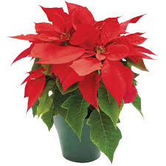
State Priority – Widows program
Mario Duguay (Chairman) marioduguay.kofc@gmail.com
The Widows program is designed to show the family of our deceased members that we have not forgotten their contribution to the Knights.
Bringing a Poinsettia with a Christmas card to our Widows will show them and their family that we care and that we are keeping them in our hearts and prayers.
It is an easy program to implement and a great way to make a difference in other people’s lives.

Slide 16
State Priority Seniors program
The Seniors Program can be done in two ways:
1. The council identifies members of the council who should be visited and informally visit these members. You can make a difference in the life of a senior member by visiting him (and his wife) assuring him that he remains important to the council and our faith community.
2. I will am offering the Compassionate Community Care visiting program for Knights of Columbus members and their wives who establish a formal visiting program. Training sessions for members and their wives can be organized by the council or the District. Contact me at: alex@epcc.ca to arrange the formal training program.

Slide 17
Life Director
Brother Alex Schadenberg
Knights of Columbus Ontario State Council
Life Director
alex@epcc.ca, 519-851-1434 (cell)
lifedirector@ontariokofc.ca

